Slide 1
Class/Object Relationships
Composition
CS(217) Object Oriented Programming

Slide 2

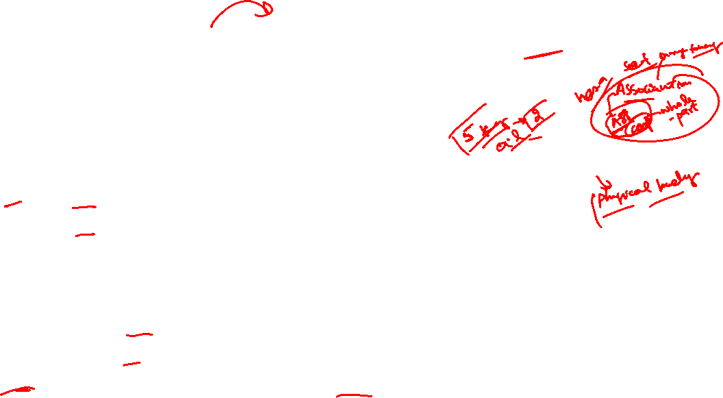
Composition (whole-part)
Subset of aggregation relation where ownership is involved
Strong relation
Object of one class can contain object(s) of other class(s) for lifetime
  one-to-one,
  one-to-many
Unidirectional object of container class knows about its parts
Objects have dependent life time (creation and destruction)
  When whole destroy part is also destroyed
  Creation and destruction of part is controlled by whole
  Part object can belong only to one whole class

Slide 3
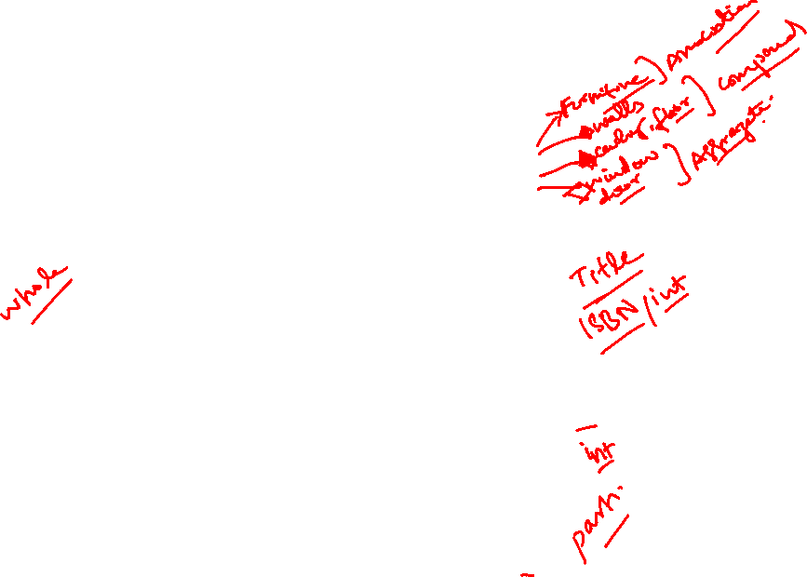
Composition (whole-part) Examples
House cannot exist without rooms.
Book cannot exist without author(s), ISBN, publisher, pages.
Person cannot exist without name, date of birth, ID, address.
House
Room
Author
Book
Publisher
Page
Date
Person
Name
Address

Slide 4
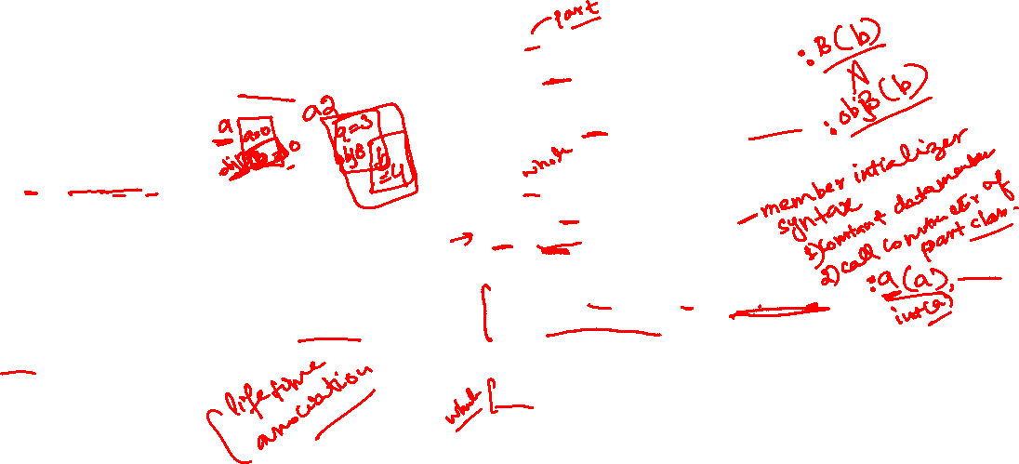
Composition (whole-part) Implementation
A
B
Add object variable as data member of class.
  void main(){
  A a, a2(3, 4);
  }
When object of A is created object of B is created inside A too.
When object of A is destroyed part object B is also destroyed.
class B{
  int b;
public:
  B(int b=0){ this->b=b;}
};
class A{
  int a;
  B objB; //variable
public:
  A(int a=0, int b=0):objB(b){
    this->a=a;
  }
  //call parametrized constructor of part
  ~A(){}
  //nothing to do with part destroyed automatically
};

Slide 5
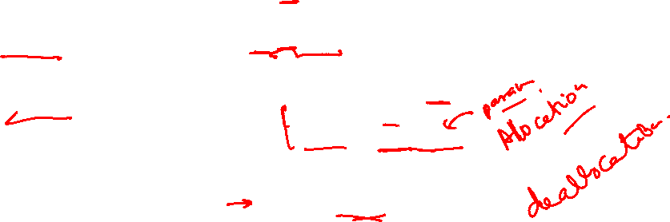
Composition (whole-part) Implementation
A
B
Add Pointer to part object as member of class.
  void main(){
  A a, a2(3, 4);
  }
When object of A is created object of B is created inside A too.
When object of A is destroyed part object B is also destroyed.
class B{
  int b;
public:
  B(int b=0){ this->b=b;}
};
class A{
  int a;
  B * objB; //pointer
public:
  A(int a=0, int b=0){
  this->a=a;
  objB = new B(b);
  //create part with whole
  }
  ~A(){ delete objB;}
  //destroy part with whole
};

Slide 6
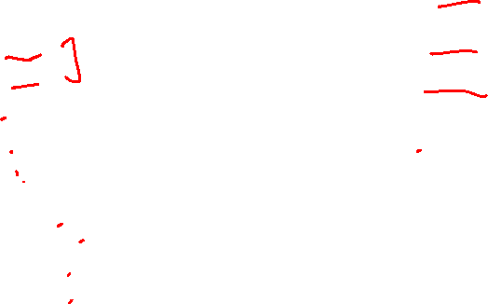
Composition (whole-part) Example
Person
Single class person controls every thing
  class Person{
    int pid;
  // Name
    char * fname;
    char * lname;
  //Date of Birth
    int day;
    int mon;
    int year;
  //Address
    char * city;
    char *country;
    int streetNo;
    int houseNo;
  };
Not scalable
Error prone
Not reusable in other class
Redefine all attributes and functions separately for other classes
For example student, doctor teacher, and patient

Slide 7
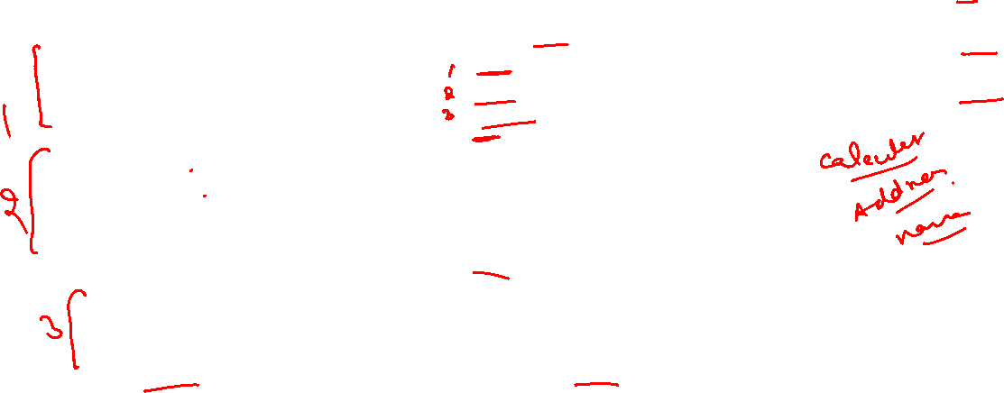
Composition (whole-part) Example
Design separate classes
  class name{
    char * fname;
    char * lname;
  };
  class date{
    int day;
    int mon;
    int year;
  };
  class address
    char * city;
    char *country;
    int streetNo;
    int houseNo;
  };
Date
  class Person{
  int pid;
  name pname;
  date dateofBirth;
  address paddress;
  };
Add objects as variables in class
Scalable
Less Error prone
Reusable in other classes such as student, doctor and teacher, patient
No need to redefine all attributes and functions separately for other classes
Person
Name
Address

Slide 8
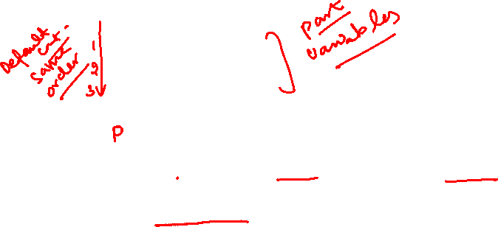
Composition (whole-part) Example
Date
Call functions of composed classes
  class Person{
  int pid;
  name pname;
  date dateofBirth;
  address paddress;
  public:
    person(int pid, char*fn, char*ln, int d, int m, int y, char*city, char*country, int street, int house)
    :pname(fn,ln), dateofBirth(d,m,y), paddress(city, country, street, house)
    {
      this->pid=pid;
    }
  //call parameterized constructors for object separately
  };
Person
Name
Address

Slide 9
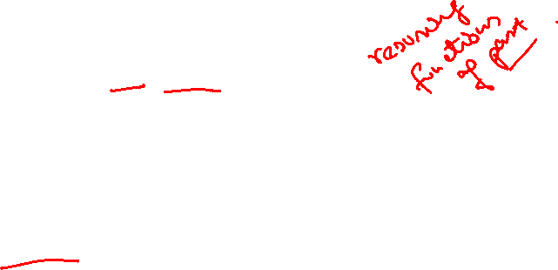
Composition (whole-part) Example
Date
Call functions of composed classes
  class Person{
  int pid;
  name pname;
  date dateofBirth;
  address paddress;
  public:
    void setName(char*fn, char*ln){
    pname.setname(fn, ln);
    }
    void setDateofBirth(int d, int m, int y){
    dateofBirth.setDate(d,m,y);
    }
    void setAddress(char*city, char*country, int street, int house){
    paddress.setaddress(city, country, street, house);
    }
  //Reuse functions of defined objects in person class
  };
Person
Name
Address

Slide 10

Composition (whole-part) Example
Date
Call functions of composed classes
  class Person{
  int pid;
  name pname;
  date dateofBirth;
  address paddress;
  public:
    char * getfirstName(){
    return pname.getfirstname();
    }
    char * getlastName(){
    return pname.getlastname();
    }
    Date getDateofBirth(int d, int m, int y){
    return dateofBirth.getDate();
    }
  //Reuse functions of defined objects in person class
  };
Person
Name
Address

Slide 11

Composition (whole-part) Example
Date
Call functions of composed classes
  class Person{
  int pid;
  name pname;
  date dateofBirth;
  address paddress;
  public:
    friend ostream& operator<< (ostream& , const Person&);
  //Reuse functions of defined objects in person class
  };
  friend ostream& operator<< (ostream& out , const Person& p){
  out<< “Person id:” << pid;
  out<< “Name:” << pname;
  out<< “Date of Birth:” << dateofBirth;
  out<< “Address:” << paddress;
  } //Call ostream operator functions of name, date and address class
Person
Name
Address

Slide 12
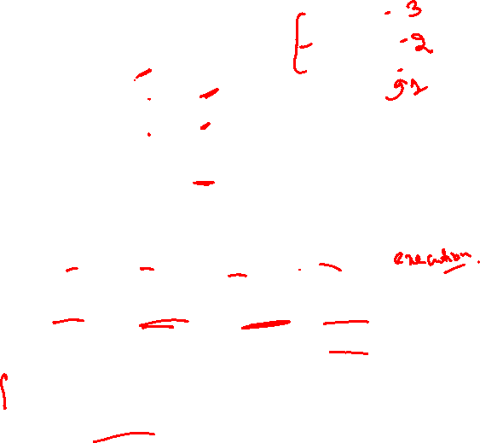
Composition (whole-part) Example
Date
pid
pname
  class Person{
  int pid;
  name pname;
  date dateofBirth;
  address paddress;
  };
  void main(){ Person p; }
Calling sequence
  Default constructor: in same order as defined objects in class
    1)name 2)date 3)address 4)person
  Destructor: in reverse order as defined objects in class
    1)person 2)address 3)date 4)name
  Parametrized constructor: called in order of member initializer syntax
    : dateofBirth(d,m,y), pname(fn,ln), paddress(city, country, street, house)
    1)date 2)name 3)address 4)person
dateofBirth
Person
Name
paddress
Address

Slide 13

Composition (whole-part) Example
Design separate classes
  class name{
    char * fname;
    char * lname;
  };
  class date{
    int day;
    int mon;
    int year;
  };
  class address
    char * city;
    char *country;
    int streetNo;
    int houseNo;
  };
Date
  class Person{
  int pid;
  name * pname;
  date * dateofBirth;
  address * paddress;
  };
Add objects as pointer to variables in class
Scalable Less Error prone
Reusable in other classes such as student, doctor and teacher, patient
No need to redefine all attributes and functions separately for other classes
Person
Name
Address
pid
name
* pname
dateofBirth
date
paddress
address

Slide 14

Composition (whole-part) Example
Date
Call functions of composed classes
  class Person{
  int pid;
  name * pname;
  date * dateofBirth;
  address * paddress;
  public:
    person(int pid, char*fn, char*ln, int d, int m, int y, char*city, char*country,
    int street, int house)
    { pname = new name(fn, ln);
    dateofBirth = new date(d, m, y);
    paddress = new address(city, country, street, house);
      this->pid=pid;
    }
  //call parameterized constructors for dynamic objects
  };
Person
Name
Address

Slide 15

Composition (whole-part) Example
Date
Call functions of composed classes
  class Person{
  int pid;
  name * pname;
  date * dateofBirth;
  address * paddress;
  public:
    void setName(char*fn, char*ln){
    pname->setname(fn, ln);
    }
    void setDateofBirth(int d, int m, int y){
    dateofBirth->setDate(d,m,y);
    }
    void setAddress(char*city, char*country, int street, int house){
    paddress->setaddress(city, country, street, house);
    }
  //Reuse functions of defined objects in person class
  };
Person
Name
Address

Slide 16
Composition (whole-part) Example
Date
Call functions of composed classes
  class Person{
  int pid;
  name * pname;
  date * dateofBirth;
  address * paddress;
  public:
    ~person()
    { delete pname;
    delete dateofBirth ;
    delete paddress;
    }
  //call destructors of composed objects within destructor of person, sequence is controlled by programmer
  };
Person
Name
Address

Slide 17
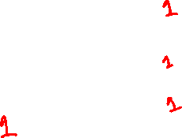
Composition (whole-part) Example
Date
  class Person{
  int pid;
  name * pname;
  date * dateofBirth;
  address * paddress;
  };
  void main(){Person p;}
Calling sequence
  System will only call constructors and destructor of Person
  Programmer controls the ordering and call of constructors and destructor, for composed objects.
Person
Name
Address

Slide 18
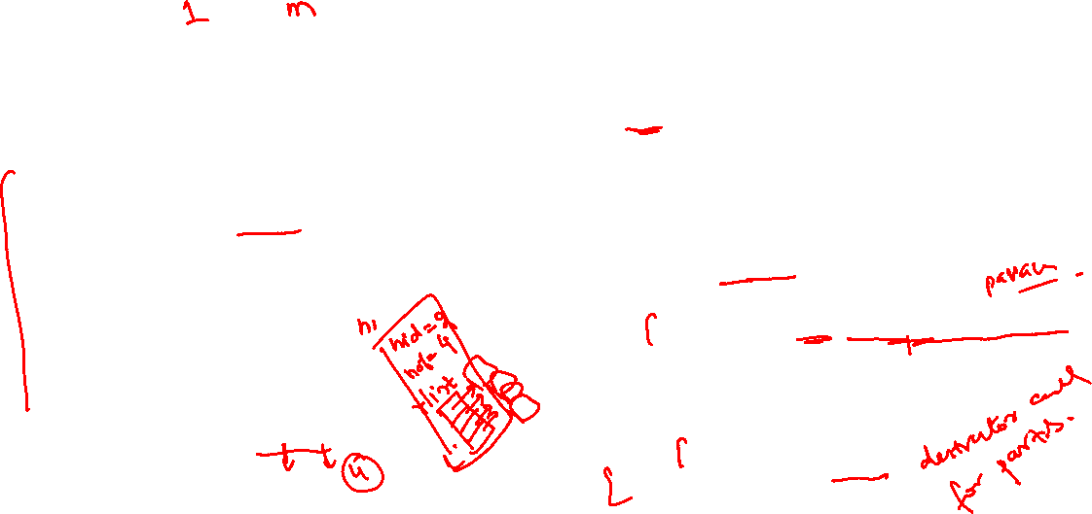
Composition (whole-part) Example
House
Room
class House{
  int hid;
  int noofrooms;
  Room ** rList; //pointers list
public:
  House(int id=0, int rooms=2){
  hid = id;
  noofrooms = rooms;
  rList = new Room*[noofrooms];
  for(int i=0; i<noofrooms; i++)
  rList[i] = new Room(i+1, i+10*i+10);
  } //create part with whole
  ~House(){
    for(int i=0; i<noofrooms; i++)
    delete rList[i];
    delete [] rList;
  } //destroy part with whole
};
One to many
class Room{
  int rid;
  float size; //in sqfeet
public:
  Room(int t=0, float s=0.0f){
    tid=t;
    Size = s;
    }
};
void main(){ House h1(2, 4); }

